Slide 1

DATA CLEANING AND CSV ANALYSIS PIPELINE
PYTHON PROGRAMMING – CSA0804
Supervisor
Dr. C. Rohith Bhat
Student Name
Register Number
S. Surender | - 1924260070
R . Deepak | - 1924260153
I. Sundar | - 1924260178
A. Swagath | - 1925260056
L. Monish | - 1972260035

Slide 2


TABLE OF CONTENT
ABSTRACT
INTRODUCTION
PROBLEM INDENTIFICATION AND ANALYSIS
SOLUTION DESIGN AND IMPLEMENTATION
RESULTS AND COMPARISON
LIMITATIONS AND FUTURE SCOPE
CONCLUSION
REFERENCES

Slide 3
ABSTRACT
This project develops a Python-based pipeline to automate the extraction, cleaning, and analysis of raw CSV datasets.
It leverages libraries like Pandas to handle missing values, standardize formats, and remove duplicates efficiently.
The pipeline outputs structured, analysis-ready data alongside exploratory visual summaries.
Ultimately, it significantly reduces manual preprocessing time and ensures data reliability for downstream tasks.

Slide 4
INTRODUCTION
High-quality data is the foundational requirement for accurate analytics and data science workflows.
However, raw data collected from various sources is often messy, inconsistent, and stored in unoptimized CSV formats.
Manual data cleaning is notoriously time-consuming, prone to human error, and difficult to scale across large datasets.
This capstone introduces a standardized, automated Python pipeline to streamline data preparation from ingestion to initial analysis.

Slide 5
PROBLEM STATEMENT
Raw CSV datasets consistently contain missing values, duplicate records, and incorrect data types that disrupt analytical models.
Data professionals spend a disproportionate amount of time manually cleaning data rather than extracting actionable insights.
Many organizations lack standardized, reusable workflows, leading to inconsistent data handling across different projects.
There is a critical need for an automated, end-to-end Python pipeline that efficiently and reliably transforms messy CSVs into analysis-ready data.

Slide 6
ARCHITECTURE DIAGRAM
Remove Duplicates
Handle Missing
Values
Business Rules
Constrains
Raw Data
Cleaning
Validation
Reporting
Clean Data
Change Report

Slide 7
MODULE - 1
Environment Setup & Data Acquisition
Establishes a reproducible Python environment (venv/conda + core libraries).
Focuses on programmatic data acquisition, not manual downloads, so the process can be repeated.
Involves initial, lightweight inspection only — no cleaning yet.
Output is raw, unmodified data stored separately from cleaned data.

Slide 8
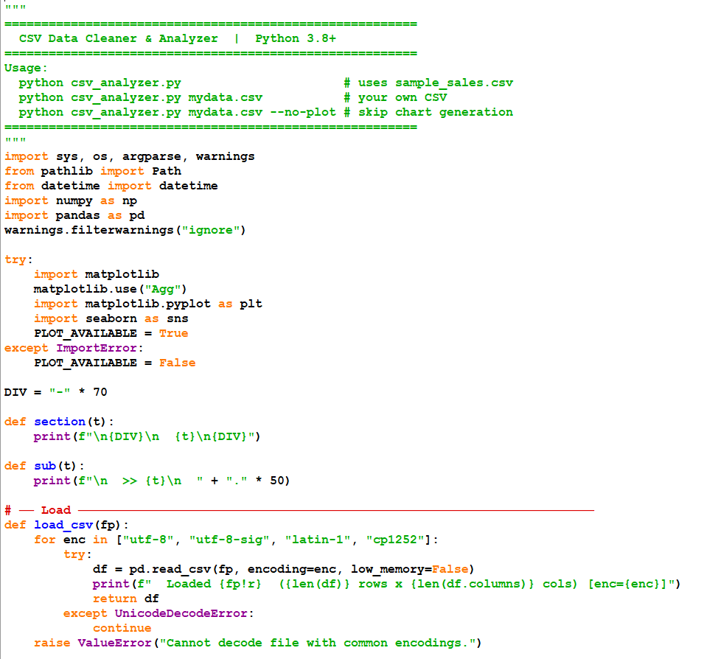
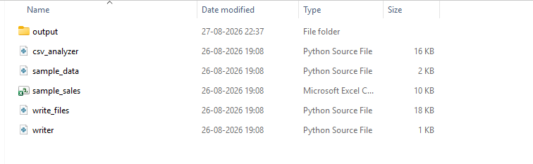
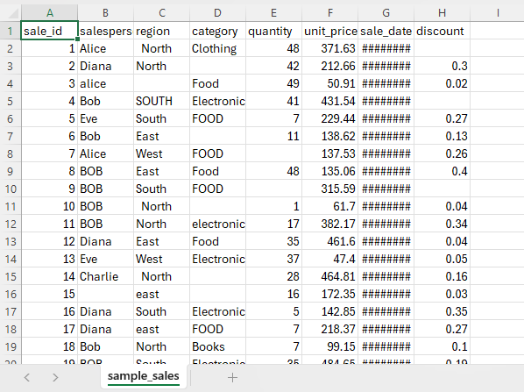

Slide 9
MODULE - 2
Data Quality Assessment
Purely diagnostic — no data is changed in this module.
Covers four key issue types: missing values, duplicates, formatting inconsistencies, outliers.
Uses visualizations (heatmaps, boxplots) to make issues easy to communicate.
Produces a documented "data quality report" that justifies later cleaning decisions.

Slide 10
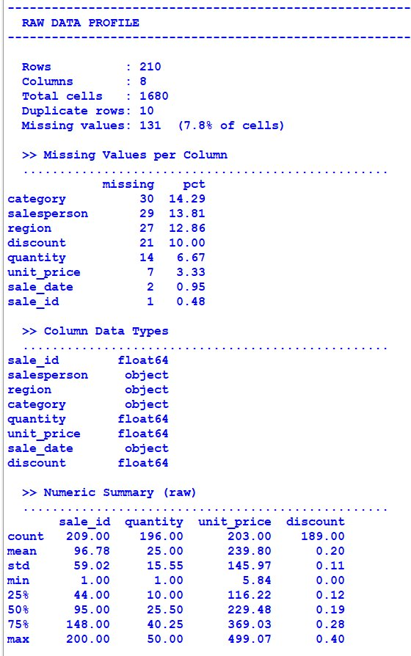
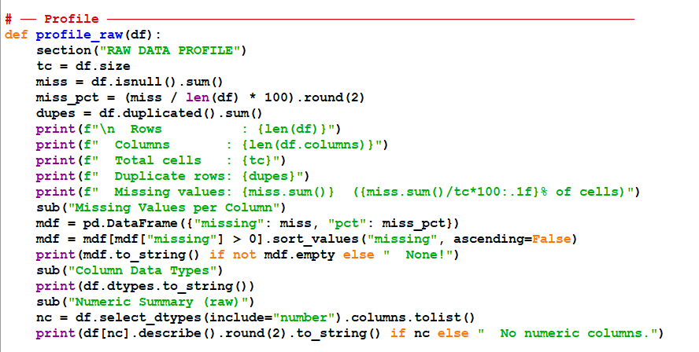

Slide 11
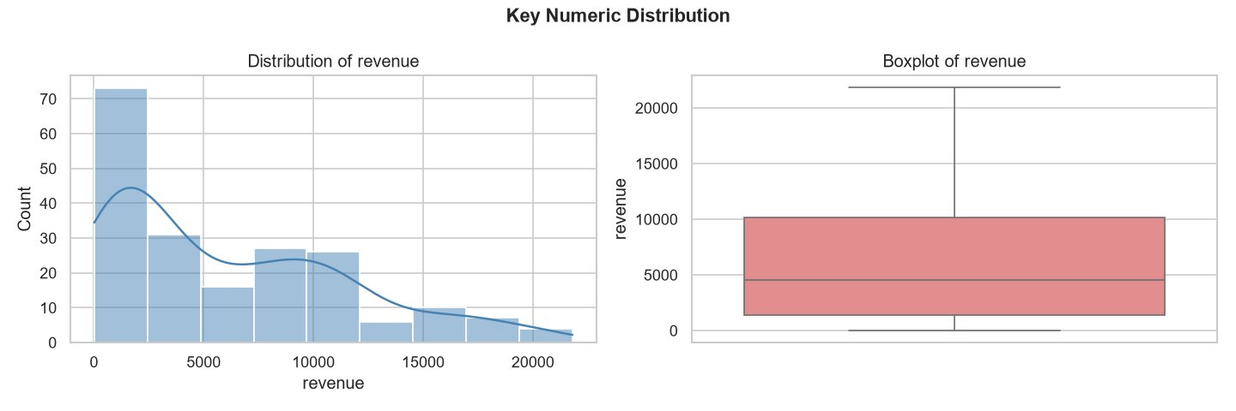
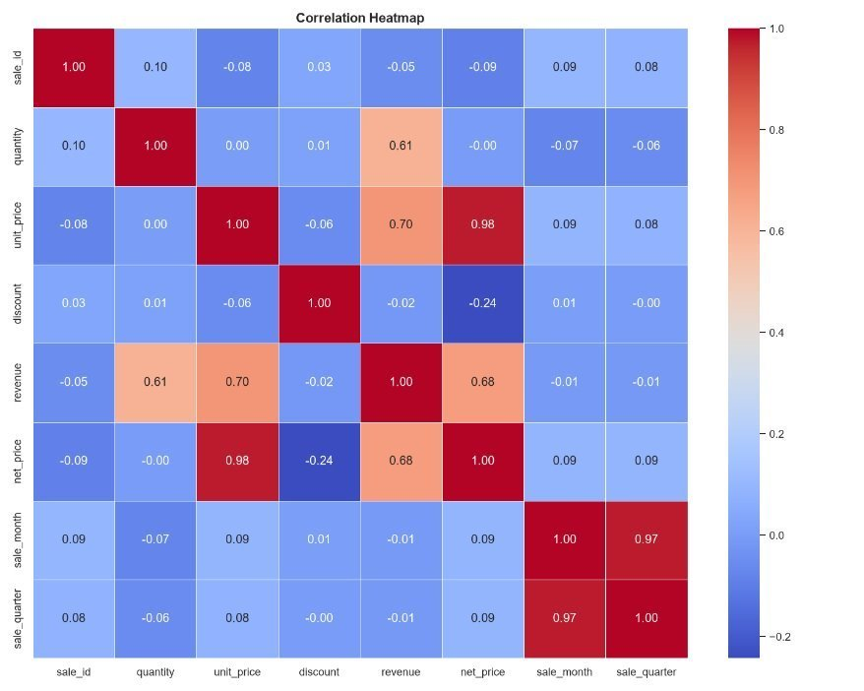
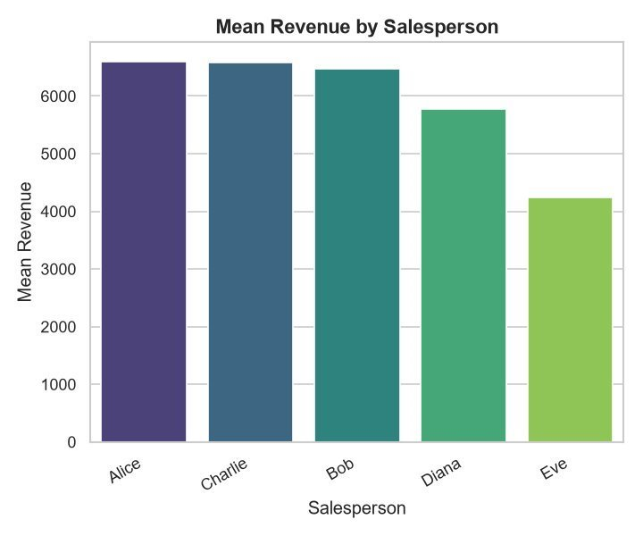

Slide 12
MODULE - 3
Data Cleaning
The core technical module — directly addresses every issue found in Module 2.
Emphasizes reusable functions over one-off notebook fixes, so cleaning logic can run on new data.
Requires justifying each cleaning decision (why impute vs. drop, why cap vs. remove outliers).
Produces a clean, analysis-ready dataset as a separate file from the raw one.

Slide 13
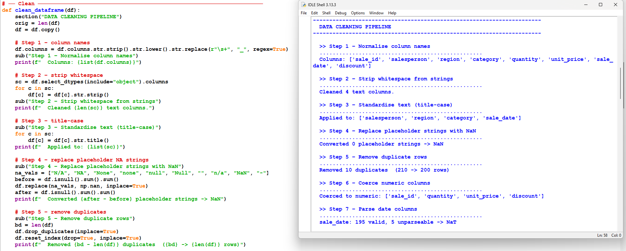

Slide 14
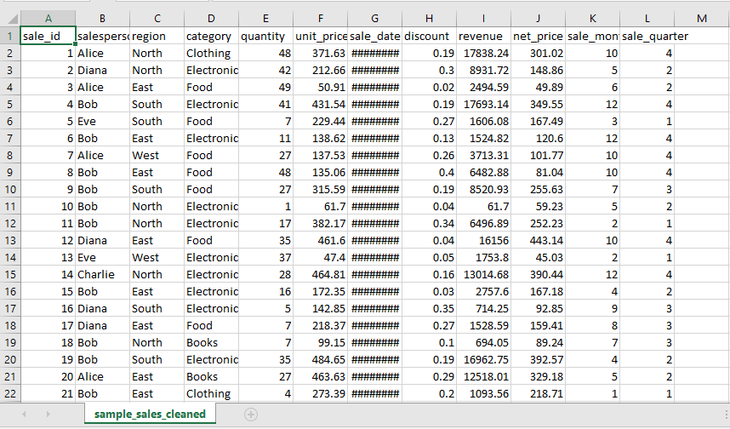
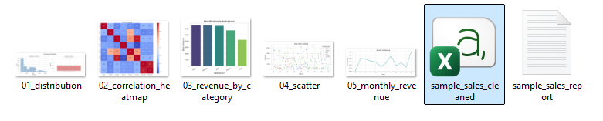

Slide 15
MODULE - 4
Exploratory Data Analysis (EDA) & Transformation
Shifts from "fixing" data to "understanding" data.
Combines statistical summaries with visual analysis (univariate, bivariate, multivariate).
May include feature engineering (new columns, encodings, bins) to support analysis.
Ends with a concrete insights summary, not just charts.

Slide 16
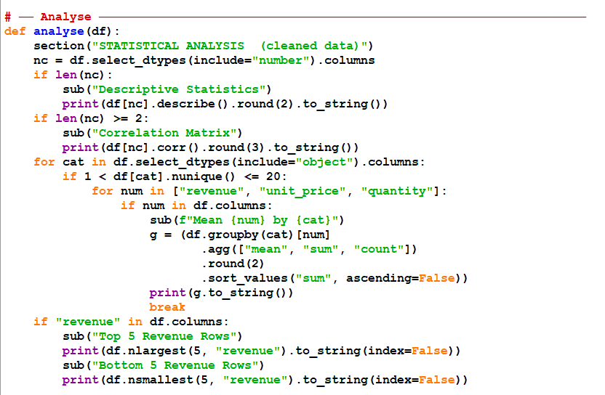
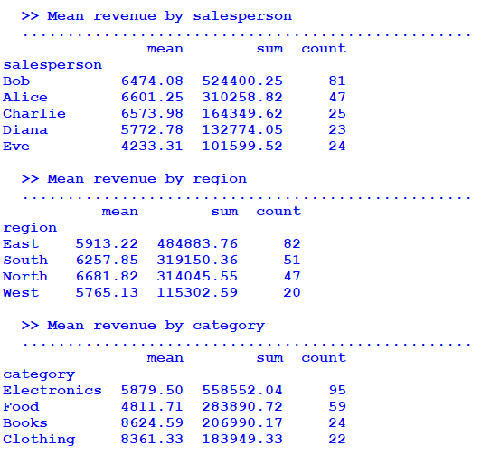

Slide 17
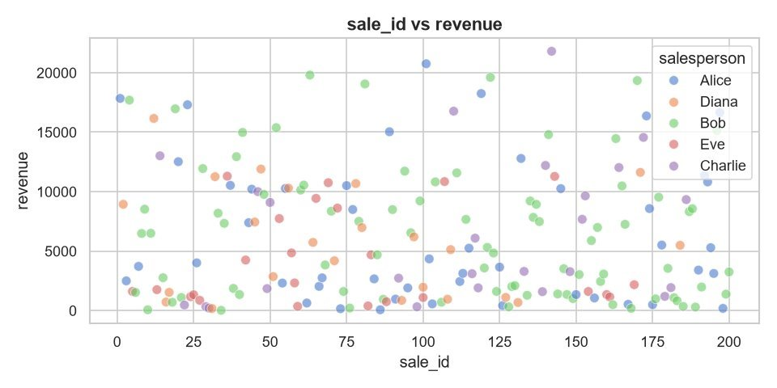
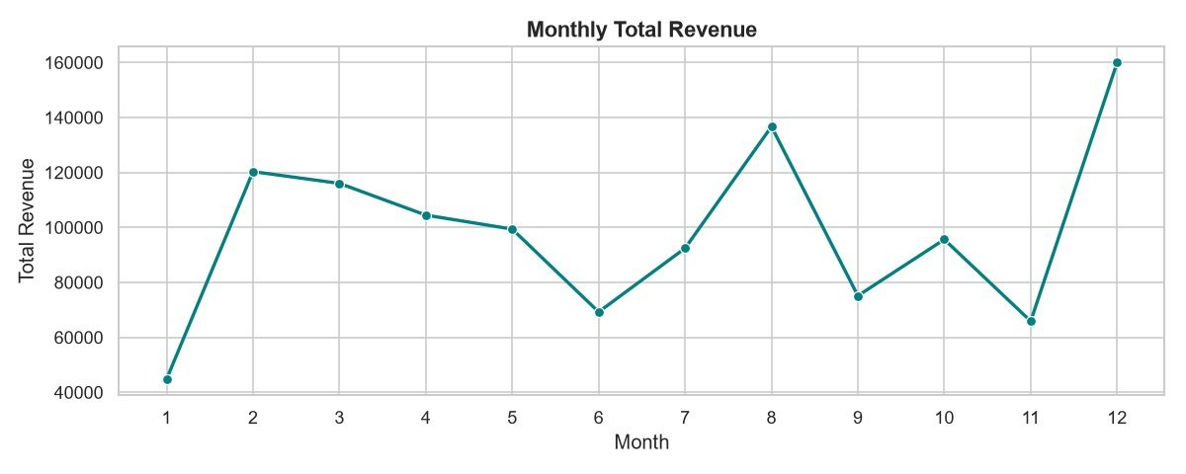

Slide 18
MODULE - 5
Pipeline Automation & Reporting
Integrates Modules 1–4 into a single, automated, end-to-end script.
Adds production-quality practices: logging, error handling, optional CLI.
Generates an automated report/output, making the pipeline reusable on any new CSV.
Final deliverable ties technical work to communication — README + presentation.

Slide 19
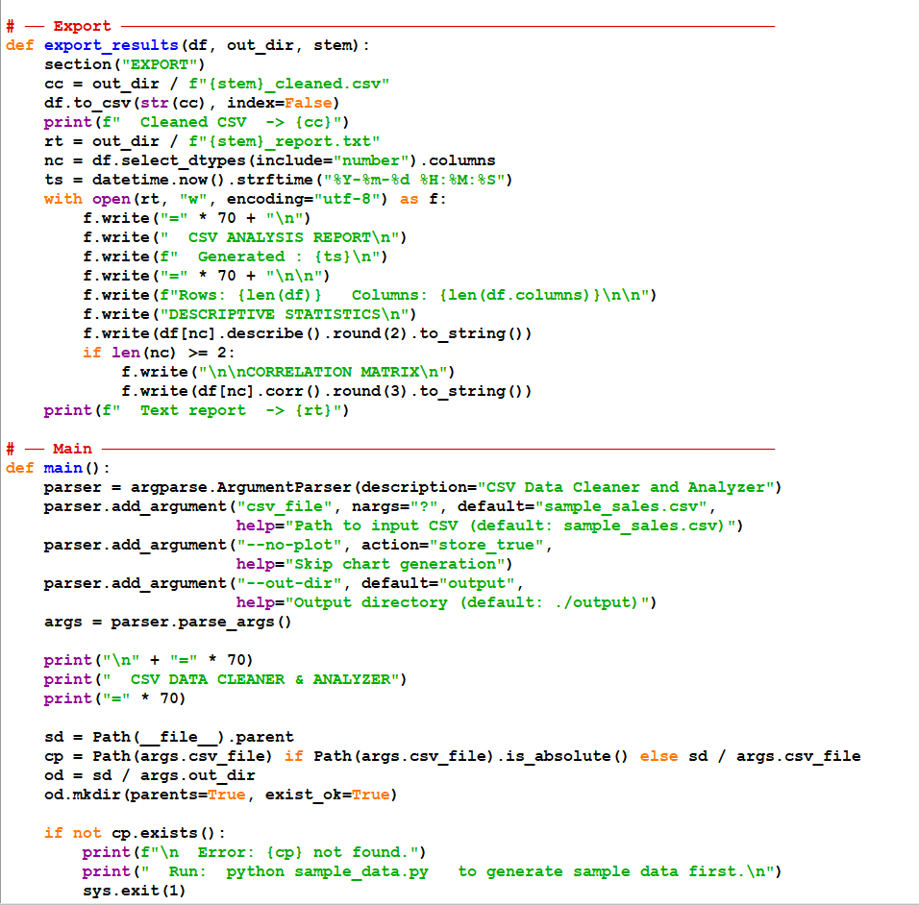
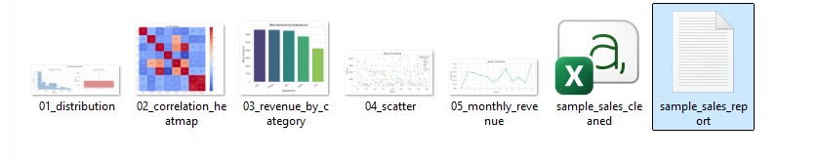
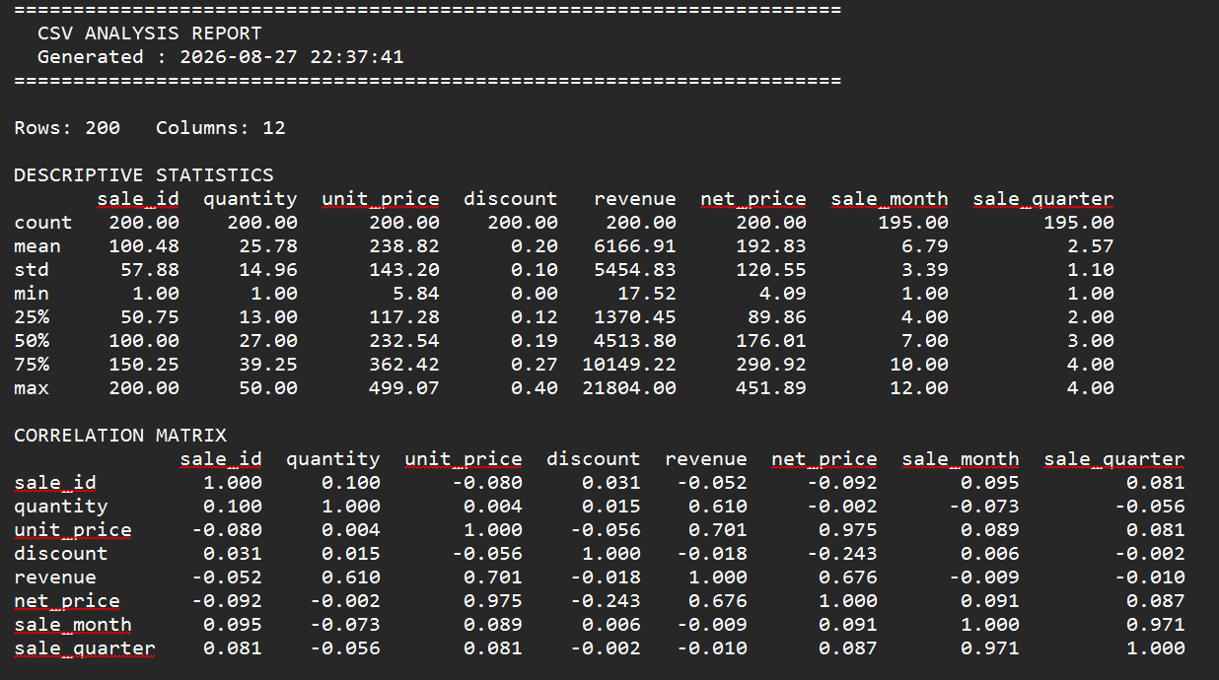

Slide 20
RESULTS AND COMPARISON
Results:
Raw dataset successfully acquired — report rows, columns, file size.
Quantify issues found — e.g., "X% missing values in column Y", "Z duplicate rows", "N outliers detected in column A".
Report metrics before → after — e.g., missing values: 12% → 0%, duplicates: 340 → 0, rows retained: 98%.
Key statistical findings — top correlations, notable trends, group differences (e.g., "Category X has 2x higher average than Category Y").
Pipeline run time, success rate on new/unseen CSVs, automated report generated.
Comparison
Manual download vs. scripted fetch → scripted version is reproducible and re-runnable on schedule/on demand.
Raw data profile vs. ideal/expected data profile — this gap becomes your cleaning checklist.
Raw dataset vs. cleaned dataset (row count, column dtypes, memory usage)
Pre-cleaning insights (unreliable, skewed by bad data) vs. post-cleaning insights (accurate) — demonstrates why cleaning mattered.
Manual step-by-step process (time-consuming, error-prone) vs. automated pipeline (fast, consistent, one-command execution) — quantify time saved if possible.

Slide 21
LIMITATIONS & FUTURE SCOPE
Limitations
Dataset-specific cleaning logic — cleaning rules (e.g., outlier thresholds, imputation methods) are tailored to the chosen dataset and may not generalize well to datasets with very different structures or domains.
No handling of very large datasets — pandas-based pipeline works in-memory, so it may struggle with datasets too large to fit in RAM (no distributed processing like Spark/Dask).
Manual justification required for cleaning decisions — choices like "drop vs. impute" or "cap vs. remove outliers" still need human judgment; the pipeline doesn't auto-decide the best strategy.
Limited to structured/tabular CSV data — doesn't handle unstructured data (text, images, JSON nesting) or semi-structured formats without extra preprocessing
Future Scope
Integrate with big data tools — extend pipeline to use PySpark or Dask for handling large-scale datasets beyond memory limits.
Add machine learning-based cleaning — use ML models for smarter imputation (e.g., KNN imputer, regression-based) and anomaly detection (Isolation Forest, DBSCAN).
Build a web interface/dashboard — wrap the pipeline in a Streamlit/Flask app so non-technical users can upload a CSV and get cleaned data + reports via UI.
Support multiple file formats — extend beyond CSV to Excel, JSON, Parquet, and database connections (SQL).

Slide 22
CONCLUSION
Successfully designed and implemented an end-to-end data cleaning and CSV analysis pipeline covering acquisition, quality assessment, cleaning, analysis, and automated reporting.
Demonstrated the critical role of data cleaning in ensuring reliable analysis — raw data with missing values, duplicates, and inconsistencies would have led to skewed or incorrect insights if used directly.
Built reusable, modular components (fetch, clean, EDA, pipeline scripts) rather than one-off notebook code, making the solution applicable to new datasets with minimal changes.
Automated a traditionally manual and error-prone process, reducing processing time and improving consistency through a single-command pipeline with logging and error handling.
Gained practical, industry-relevant skills in Python data science tools (pandas, numpy, matplotlib/seaborn) that mirror real-world data engineering and analytics workflows.
Identified clear directions for improvement — including scalability, ML-based cleaning, and multi-source support — showing the project as a solid foundation rather than a finished, closed system.

Slide 23
REFERENCES
McKinney, W. (2010). pandas: Python Data Analysis Library.
Harris, C.R., et al. (2020). Array programming with NumPy. Nature 585, 357–362.
Hunter, J.D. (2007). Matplotlib: A 2D Graphics Environment. Computing in Science & Engineering.
Waskom, M. (2021). seaborn: statistical data visualization. Journal of Open Source Software.
Kazil, J. & Jarmul, K. (2016). Data Wrangling with Python. O'Reilly Media.
VanderPlas, J. (2016). Python Data Science Handbook. O'Reilly Media.
Wickham, H. (2014). Tidy Data. Journal of Statistical Software, 59(10).
Tukey, J.W. (1977). Exploratory Data Analysis. Addison-Wesley. (Source of the IQR outlier method).
Little, R.J.A. & Rubin, D.B. (2019). Statistical Analysis with Missing Data (3rd ed.). Wiley.
Osborne, J.W. (2012). Best Practices in Data Cleaning. SAGE Publications.

Slide 24

07/08/2026

